Slide 1

Introduction of Past Research
Name: Chenxi Duan

Slide 2
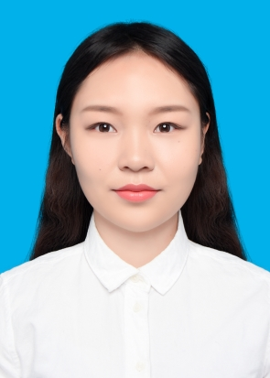
1 Curriculum Vitae
Chang’an University
Bachelor
Remote Sensing Science and Technology
GPA: 3.78 / 4.00
Rank: 1 / 36
Master
Wuhan University
Surveying and Mapping Engineering
GPA: 3.51 / 4.00
Rank: 6/51

Slide 3
1 Curriculum Vitae
Awards and Honors
2015-2016 National Scholarship (6/502)
2016-2017 National Scholarship (6/502)
2018-2019 Truth-seeking Star Scholarship (10 students in Chang’an University)
2018-2019 Outstanding member of Communist Party (6/502)
2019 Scholarship of Outstanding Undergraduate (23/502)
2019-2020 Outstanding Academic Scholarship
RESEARCH EXPERIENCE
Duan C, Pan J, Li R. Thick Cloud Removal of Remote Sensing Images Using Temporal Smoothness and Sparsity Regularized Tensor Optimization. Remote Sens. 2020, 12, 3446.
Cong M, Duan C*, Xu M, Tao Y. Road Extraction from High Resolution Remote Sensing Image based on Shape Analysis with Gestalt Theory. Remote Sensing Technology and Application, 2019, 34(3): 595-601.
Li R, Zheng S, Duan C, et al. Classification of Hyperspectral Image Based on Double-Branch Dual-Attention Mechanism Network, Remote Sensing, 2020, 12, 582.

Slide 4
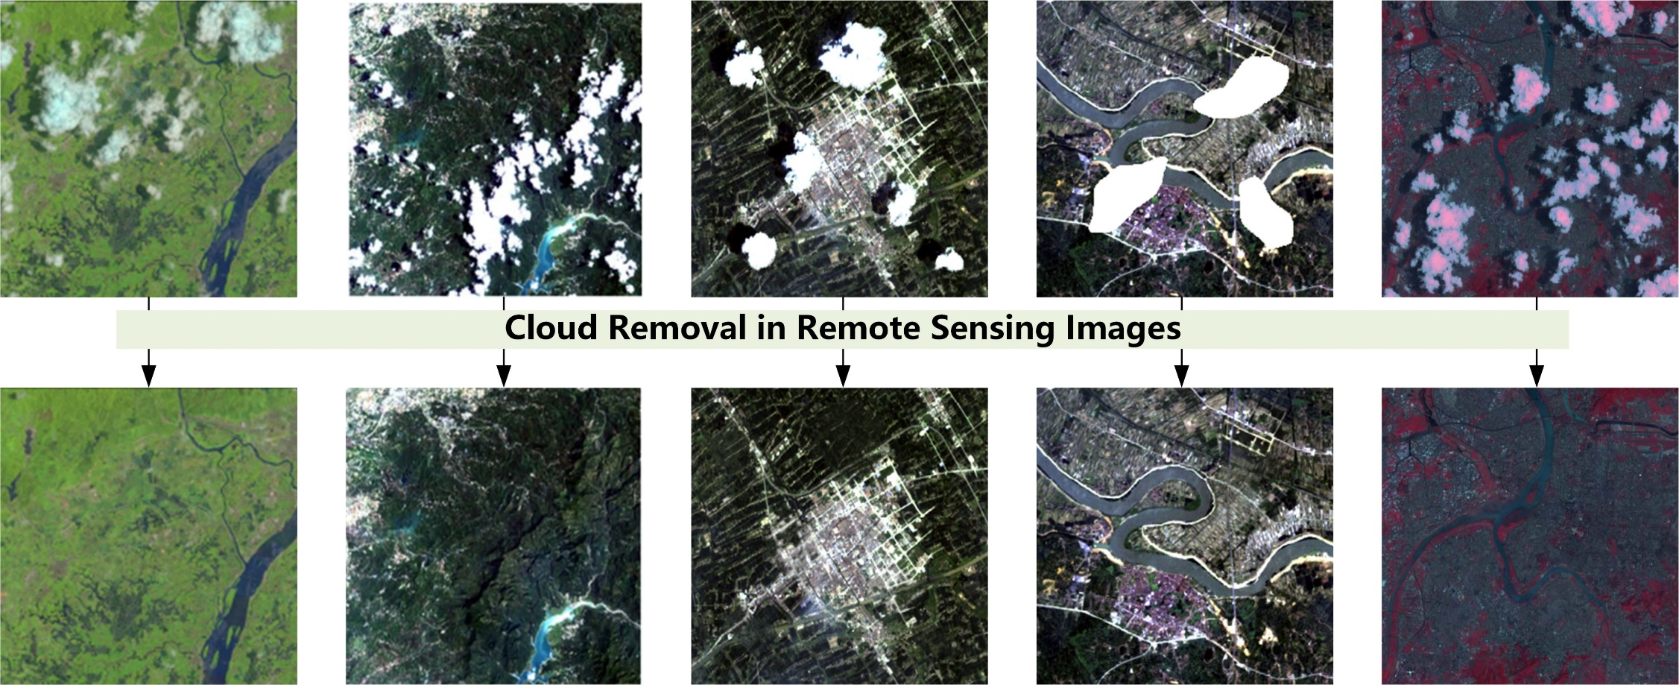
2 Cloud removal task

Slide 5
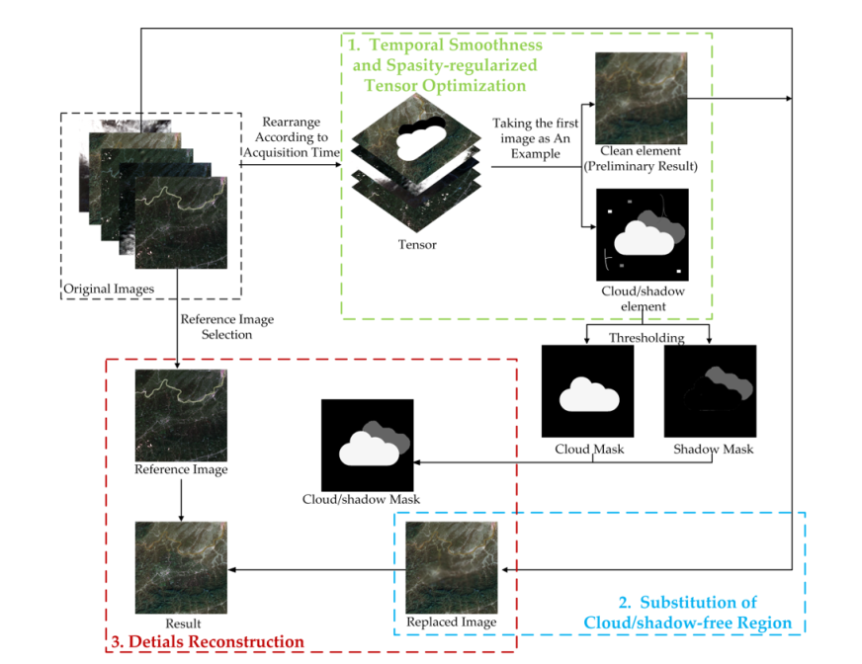

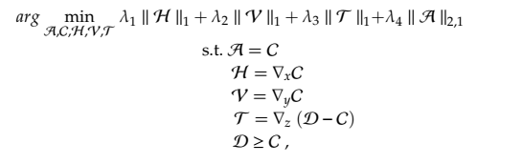
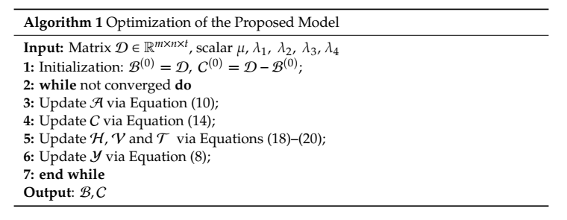
2 Cloud removal task

Slide 6
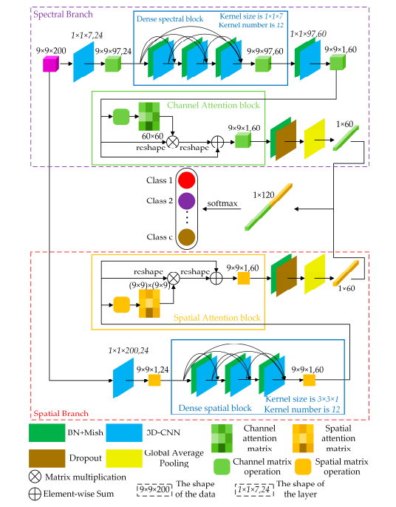
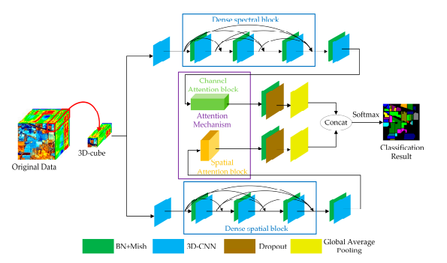
3 Classification of Hyperspectral images

Slide 7
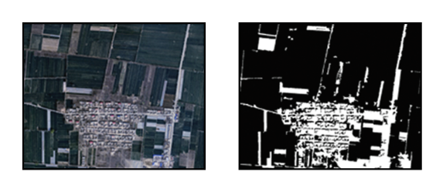

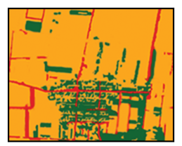
4 Road Extraction from High Resolution Remote Sensing Image
Preliminary interpretation
Calculate the reliability and classify
Width/length Road Separate
composite

Slide 8
THANKS

